Slide 1
Introduction to Java for Business BU350.700.51 Spring I 2025
Common Types of Programming Errors

Slide 2
Common Types of Programming Errors
Syntax Errors are errors that occur because code contains incorrect Java syntax.
Logic Errors are errors in the code that cause it to produce incorrect results for the problem being solved.
Runtime Errors are errors that occur when a program is executed and they cause the program to terminate abnormally.

Slide 3
Syntax Errors
This program has a syntax error. The semicolon that is needed to terminate the System.out.println() statement is missing.
public class SyntaxErrorDemo1
{
public static void main( String [] args )
{
int x = 10;
System.out.println( “The value of x is “ + x )
}
}

Slide 4
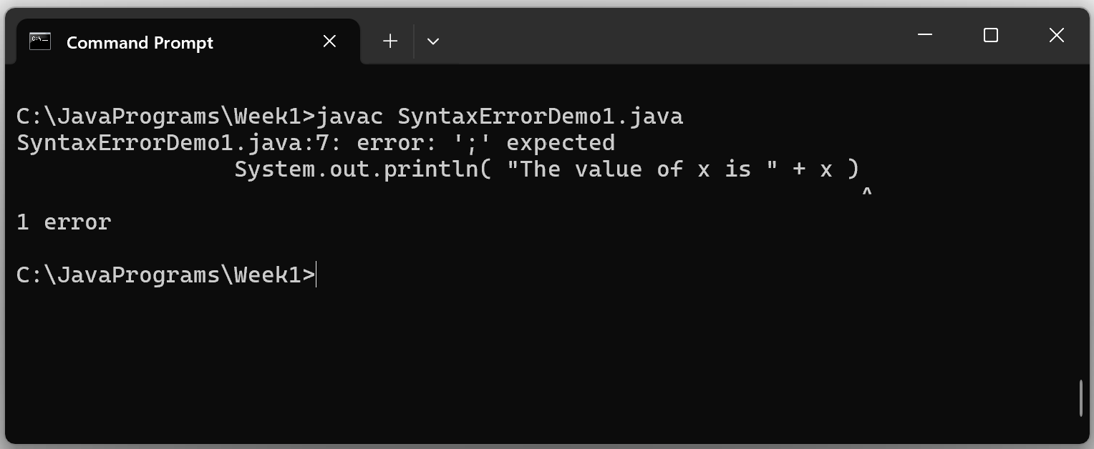
How Errors Appear On The Command Line

Slide 5
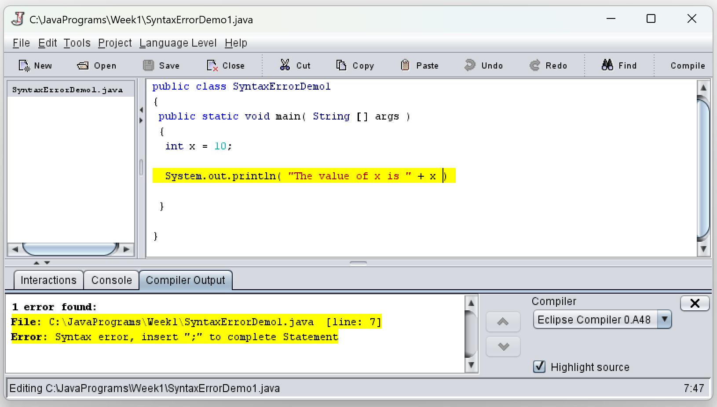
How Errors Appear On An IDE

Slide 6
Logic Errors
This program has a logic error. The formula for computing the perimeter is incorrect.
// Program to compute the perimeter of a rectangle
class LogicErrorDemo1
{
public static void main( String [] args )
{
int side1 = 10; // side of a rectangle
int side2 = 20; // side of a rectangle
int side3 = 30; // side of a rectangle
int side4 = 40; // side of a rectangle
int perimeter = side1 + side2 + side3;
System.out.println( “The perimeter is “ + perimeter );
}
}

Slide 7
Runtime Errors
This program has a runtime error. The zero denominator value will cause the program to terminate abnormally.
// Program to divide two integers
class RuntimeErrorDemo1
{
public static void main( String [] args )
{
int value1 = 40; // numerator
int value2 = 0; // denominator
int result = value1 / value2;
System.out.println( “The result is “ + result );
}
}

Slide 8
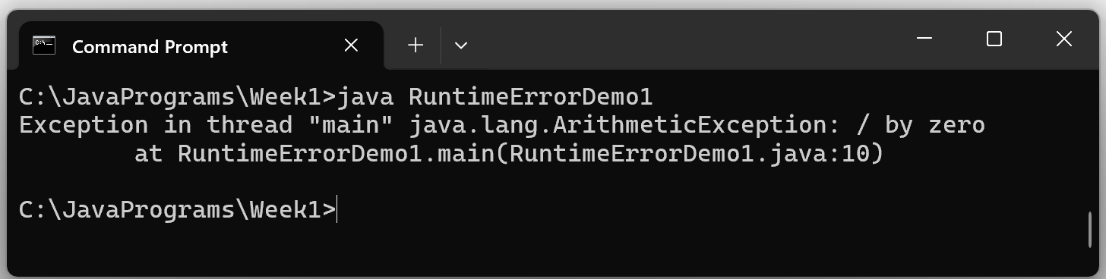
Runtime Errors

